Slide 1
W9 Community Boosters review
🏋️‍♂️ Focus on training & empowerment of local boosters

Slide 2
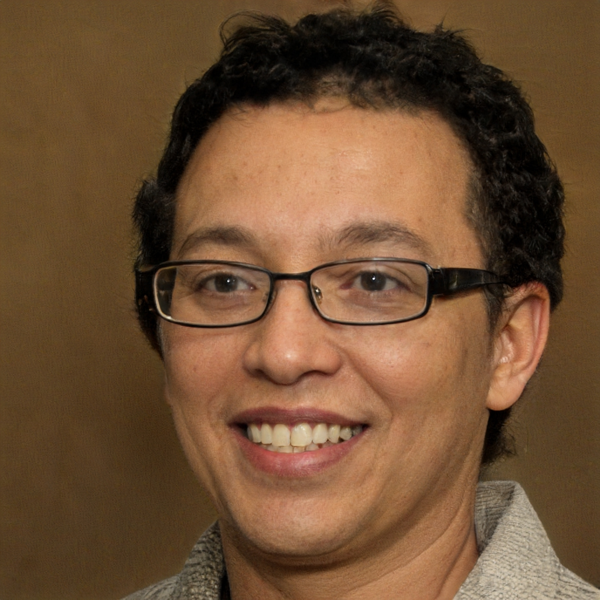
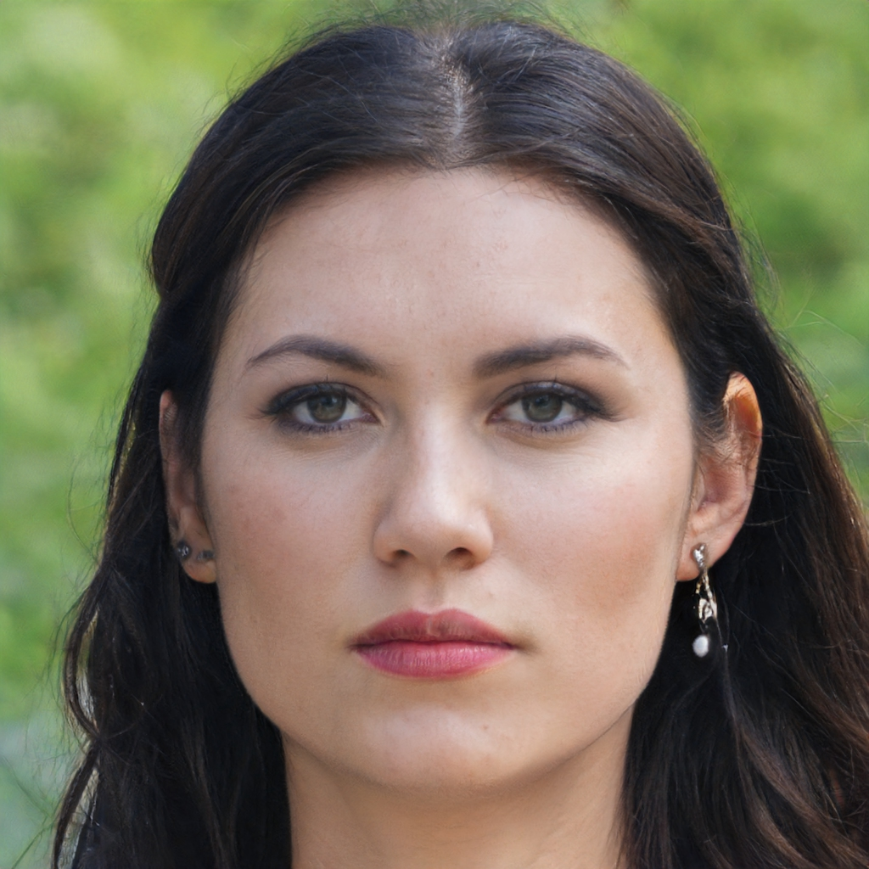
Community Booster review Example of workshop results
Candidate or future Community Booster | Next moves / actions
Rick | 🎖️Achievements : Identify deeds to perform for the Community ⌛Resources and capacity : Negotiate with manager for availabilities to ramp-up
Donna | 🔥Skills : Organize training on Community Canvas 👍 Current position & recognition : Officialize her role as a Community Booster trainee
Rick is skilled and recognized as a potential leader but has a low availability and has not achieved anything significant for the Community yet.
Donna is motivated and has already contributed to the Community. She also has time to ramp-up. However, she lacks official recognition for the moment and skills for a future position.

Slide 3
Community Boosters review Example of grading system
🎯 Intention (10 pts) :
(2) Loves the Community
(2) Has interest in developing the Community
(2) Likes Community Development
(1) Has his/her own viewpoint about how the Community should evolve
(1) Has intention to self-develop (skills, wisdom, leadership…) through Community Boosting
(1) Makes room in his/her agenda for Community activities
(1) Is an active resource seeker for Community purposes
⌛Resources and capacity (10 pts) :
(2) Has enough means of action to be Community Booster
(2) Has enough availability to be Community Booster
(2) Is allowed to be a Community Booster
(1) Has access to resources (training, content, …) to become Community Booster
(3) Has access to opportunities (events, negotiations, rights…) to progress into a Community Booster
🔥Skills (10 pts) :
(2) Member centric Skills (Caring, follow-up progression, bonding, Sense of belonging, Links & Ties, conflict management, leadership)
(2) Partner centric skills : External Sponsors, stakeholders, peer skills (negotiation, diplomacy, …)
(1) Skills related to Community Topic (specific expertise, …)
(1) Moment centric skills (Events management, One-to-one management)
(1) Content Generation skills
(1) Community Structuring (setting up tools, organizing groups, set up rules…)
(2) Community frameworks : Community Canvas, Community Engagement Framework, #OpenSeriousCommunity, #OSG workshops
👍 Current positioning & recognition (10 pts) :
(1) Declares himself/herself as a future Community Booster
(2) Has shown (to the Community) the intention the lead the Community or part of the Community
(1) Has officialized a title equivalent to Community Booster (that grants decisional power and/or responsibilities) for all or a part of the Community
(2) Is recognized by the majority of the Community as a Community Booster, or at least locally
(1) Is recognized by Community key influential members as a Community Booster
(1) Is recognized outside the Community as a Booster
(2) Community has explicit expectations towards him/her as a Booster
🎖️Achievements (10 pts) :
(4) Has accomplished enough valuable actions for Community members
(2) Has accomplished enough promotional and external actions as a Community representative outside the Community
(3) Has accomplished enough valuable actions for key stakeholders or key influential members of the Community
(1) Has accomplished enough valuable actions for self thanks to the Community

Slide 4

Community Boosters review Example of grading system
🎯 Intention (10 pts) :
(2) Loves the Community
(2) Has interest in developing the Community
(2) Likes Community Development
(1) Has his/her own viewpoint about how the Community should evolve
(1) Has intention to self-develop (skills, wisdom, leadership…) through Community Boosting
(1) Makes room in his/her agenda for Community activities
(1) Is an active resource seeker for Community purposes
⌛Resources and capacity (10 pts) :
(2) Has enough means of action to be Community Booster
(2) Has enough availability to be Community Booster
(2) Is allowed to be a Community Booster
(1) Has access to resources (training, content, …) to become Community Booster
(3) Has access to opportunities (events, negotiations, rights…) to progress into a Community Booster
🔥Skills (10 pts) :
(2) Member centric Skills (Caring, follow-up progression, bonding, Sense of belonging, Links & Ties, conflict management, leadership)
(2) Partner centric skills : External Sponsors, stakeholders, peer skills (negotiation, diplomacy, …)
(1) Skills related to Community Topic (specific expertise, …)
(1) Moment centric skills (Events management, One-to-one management)
(1) Content Generation skills
(1) Community Structuring (setting up tools, organizing groups, set up rules…)
(2) Community frameworks : Community Canvas, Community Engagement Framework, #OpenSeriousCommunity, #OSG workshops
👍 Current positioning & recognition (10 pts) :
(1) Declares himself/herself as a future Community Booster
(2) Has shown (to the Community) the intention the lead the Community or part of the Community
(1) Has officialized a title equivalent to Community Booster (that grants decisional power and/or responsibilities) for all or a part of the Community
(2) Is recognized by the majority of the Community as a Community Booster, or at least locally
(1) Is recognized by Community key influential members as a Community Booster
(1) Is recognized outside the Community as a Booster
(2) Community has explicit expectations towards him/her as a Booster
🎖️Achievements (10 pts) :
(4) Has accomplished enough valuable actions for Community members
(2) Has accomplished enough promotional and external actions as a Community representative outside the Community
(3) Has accomplished enough valuable actions for key stakeholders or key influential members of the Community
(1) Has accomplished enough valuable actions for self thanks to the Community

Slide 5

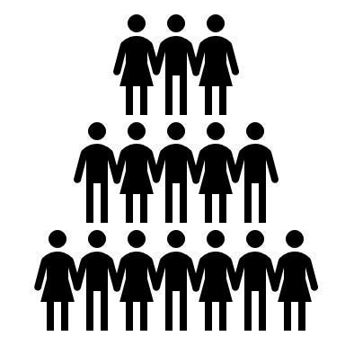





Community Boosters review Recommended assessment format
Community Data & Community Metrics
Forms or questions to Community members
Assessment by a third party (peer, manager, key community member…)
Difficulty & cost of assessment
Community Booster self assessment
🎖️Achievements
👍 Current positioning & recognition
🔥Skills
⌛Resources and capacity
🎯 Intention

Slide 6
Using KCIs to identify level of natural leadership
Know
the Community
Experience
the Community
Agree on
the Community
Achieve with
the Community
Belong to
the Community
💬
My level of interaction with members is high
🤝
Members trust me and I trust a lot of members
💞
I support members and members support me
🦚
I am proud to belong in the Community and I let people know it
👋
I know a lot of members and a lot of members know me
👍
I appreciate a lot of members and a lot of members appreciate me
🔮
Members are aligned with the Community vision I share with them
🏆
I have achieved a lot with other members
🎯
I have strong expectations towards the Community
🛠️
I am efficient in my operations for the Community
💾
I have a lot of collective good memories with members
🏳️
I have a lot of common with other members
🔭
I envision my own future in the Community
💪
I have self-actualized thanks to the Community
🔔
I regularly get members attention
👷
My role in the Community is consistent
🚀
My engagement level in the Community is high
✨
Time with me (as a Community member) is enjoyable

Slide 7
Using KCIs to identify level of natural leadership Example
Know
the Community
Experience
the Community
Agree on
the Community
Achieve with
the Community
Belong to
the Community
For each box, measure and answer the current level in the Community
Very close to reality
Close to reality
Moderately close to reality
Moderately far from reality
Far from reality
Very far from reality
💬
My level of interaction with members is high
🤝
Members trust me and I trust a lot of members
💞
I support members and members support me
🦚
I am proud to belong in the Community and I let people know it
👋
I know a lot of members and a lot of members know me
👍
I appreciate a lot of members and a lot of members appreciate me
🔮
Members are aligned with the Community vision I share with them
🏆
I have achieved a lot with other members
🎯
I have strong expectations towards the Community
🛠️
I am efficient in my operations for the Community
💾
I have a lot of collective good memories with members
🏳️
I have a lot of common with other members
🔭
I envision my own future in the Community
💪
I have self-actualized thanks to the Community
🔔
I regularly get members attention
👷
My role in the Community is consistent
🚀
My engagement level in the Community is high
✨
Time with me (as a Community member) is enjoyable

